Slide 1

Java Script and Html
week4

Slide 2
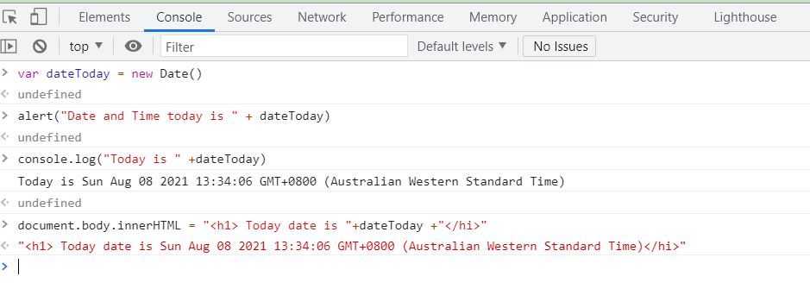
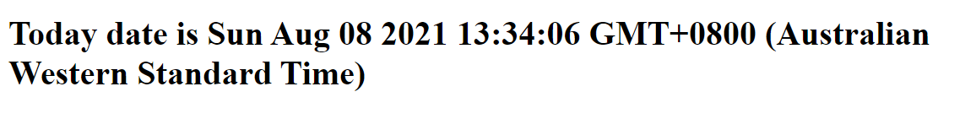
Idea: I want to inject some new HTML using Java Script

Slide 3
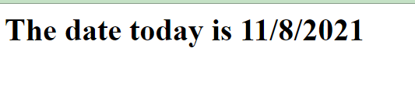
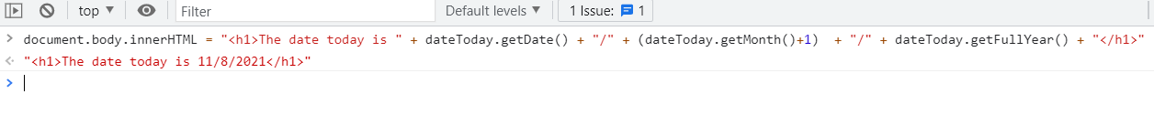
How about this?

Slide 4
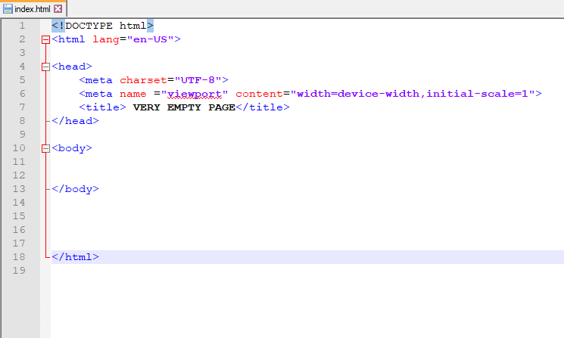
Inline Java Script to a HTML document (add to your blank page)

Slide 5
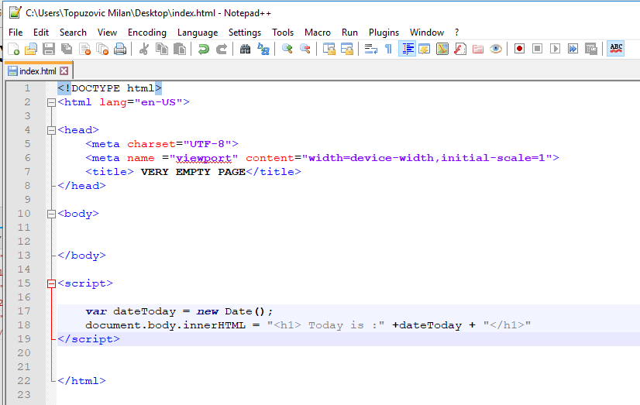
Time for script

Slide 6
Result

